Slide 1
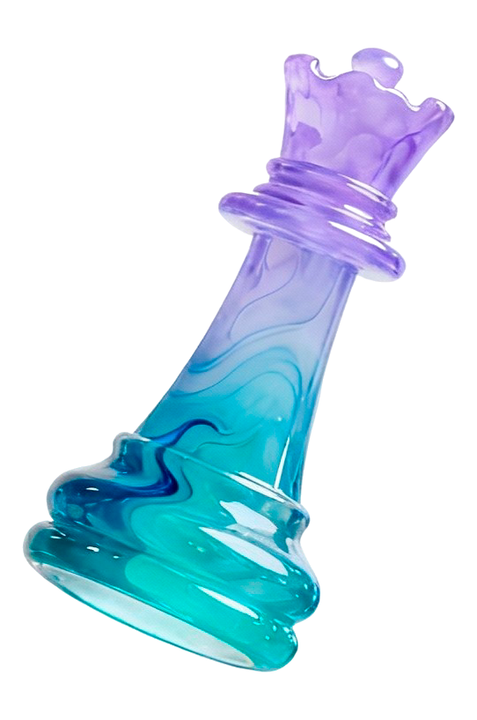
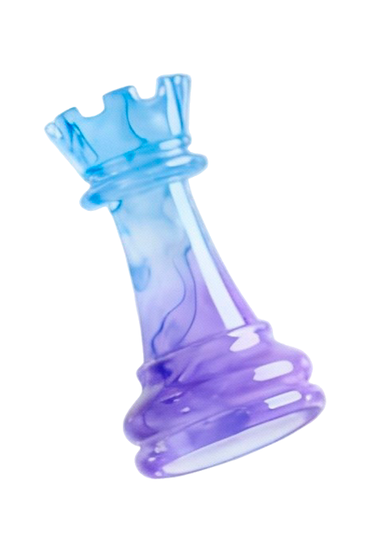
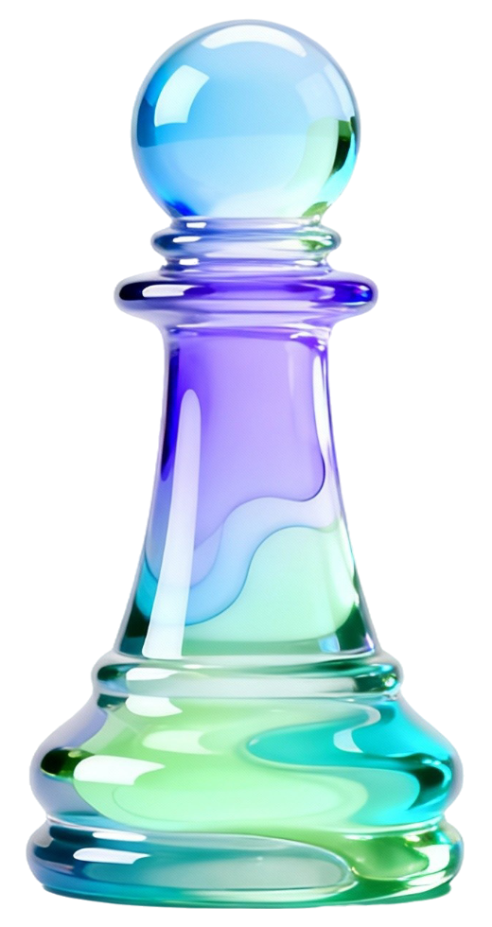
Strategy Infographics
Observation
Belief/Reward Update
Intent Inference
Here is where this template begins
Joint Action
Belief-Space
This template has been created by Slidesgo

Slide 2
Strategy infographics
Analysis
Goals
Strategy
Ejecution
Evaluation
Mercury is the closest planet to the Sun
Mercury is the closest planet to the Sun
Mercury is a small planet
Venus is the second planet from the Sun
Venus has very high temperatures
Earth is the third planet from the Sun and has life
Earth is the planet on which we live
Despite being red, Mars is actually a very cold place
It’s full of iron oxide dust
Jupiter is the biggest planet in the entire Solar System
Jupiter is a gas giant and has around eighty moons
This template has been created by Slidesgo

Slide 3
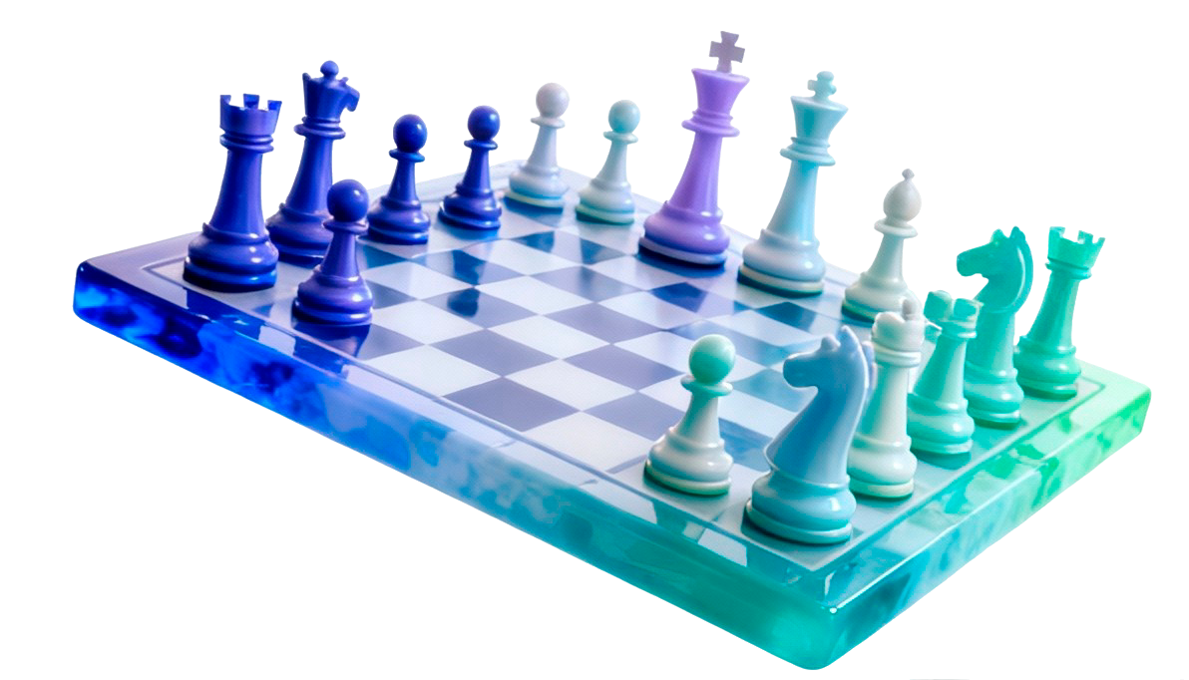
Strategy infographics
SWOT analysis
Strengths
Weaknesses
Mercury is the closest planet to the Sun and the smallest one in the Solar System. This planet’s name has nothing to do with the liquid metal
Venus has a beautiful name and is the second planet from the Sun. It’s terribly hot, and its atmosphere is extremely poisonous
Opportunities
Threats
Earth is the third planet from the Sun and the only one that harbors life in the Solar System. All humans live on this planet
Despite being red, Mars is actually a extremely cold place. It’s full of iron oxide dust, which gives the planet its reddish cast
This template has been created by Slidesgo

Slide 4
Strategy infographics
Marketing strategies
Measure awareness
Company brand building strategy
Mercury is the closest planet to the Sun
It is the closest planet to the Sun
Mercury is actually a small planet
Despite being red, Mars is a cold place
Mars is full of iron oxide dust
Mars was named after a god
Mercury is the closest planet to the Sun and the smallest one in the Solar System
Company reputation
Marketing strategies
Distribution
Venus is the second planet from the Sun
Venus has extremely high temperatures
Earth is the third planet from the Sun and has life
Earth is the planet on which we live
Jupiter is the biggest planet in the Solar System
Jupiter is a gas giant and has around eighty moons

Slide 5
Strategy infographics
Q1
Q2
Q3
Q4
Goal: What are this quarter’s goals?
Goal: What are this quarter’s goals?
Goal: What are this quarter’s goals?
Goal: What are this quarter’s goals?
Revenue: $80.000
Revenue: $100.000
Revenue: $150.000
Revenue: $300.000
Number of sales: 1000
Number of sales: 1500
Number of sales: 1700
Number of sales: 3400
Mercury is the closest planet to the Sun
It is the closest planet to the Sun
Mercury is a small planet
Venus is the second planet from the Sun
Venus has a toxic atmosphere
Venus is actually a hot planet
Earth is the third planet from the Sun and has life
Earth is the planet with life
It’s known as the Blue Planet
Despite being red, Mars is a cold place
Mars is full of iron oxide dust
Mars was named after a god

Slide 6
Strategy infographics
Mercury is the closest planet to the Sun and the smallest one in the Solar System
Analysis
Venus has a beautiful name and is the second planet from the Sun. It’s terribly hot
Earth is the third planet from the Sun and the only one that harbors life in the System
Evaluation
Goals
Despite being red, Mars is actually a cold place. It’s full of iron oxide dust
Jupiter is a gas giant and the biggest planet in the Solar System
Ejecution
Strategy

Slide 7
Strategy infographics
Sales strategy
Sales Channel | Products & Services | Budgeted Costs | Projected Sales
In Store | T-shirts, hoodies, jeans, sweatpants, graphic designs | Sales staff, Management, Logistics, POS, Leasing, Utilities | 12,000 units
Online | T-shirts, oodies, jeans, shawls, badges, graphic designs | Inventory, Website & Security, Customer Support, Marketing | 22,000 units
Wholesale | T-shirts, hoodies, crewnecks | Warehousing, Logistics, Manufacturing | 15,000 units

Slide 8
Strategy infographics
Market research & insights
Execution plan
1- 2 weeks
1
Mercury is the closest planet to the Sun and the smallest one in the System
4–5 weeks
1
Despite being red, Mars is actually a cold place. It’s full of iron oxide dust
Define vision & objectives
Implementation & monitoring
2 weeks
2
Venus has a beautiful name and is the second planet from the Sun
3-4 weeks
2
Jupiter is the fourth-brightest object in the night sky
Strategic planning
Review & optimization
3 weeks
3
Earth is the third planet from the Sun and the only one that harbors life
2 weeks
3
Saturn several rings. It’s composed mostly of hydrogen and helium

Slide 9
Strategy infographics
Mercury is the closest planet to the Sun and the smallest of them all
1
2
Venus has a beautiful name and is the second planet from the Sun
Earth is the third planet from the Sun and the only one that harbors life
3
4
Despite being red, Mars is actually a cold place. It’s full of iron oxide dust
Jupiter is the fourth-brightest object in the night sky and is a gas giant
5
6
Saturn is a gas giant and has several rings. It has a high number of moons

Slide 10
Strategy infographics
75%
80%
65%
95%
Strategy 01
Strategy 02
Strategy 03
Strategy 04
Mercury is the closest planet to the Sun
It is the closest planet to the Sun
Mercury is a small planet
Venus is the second planet from the Sun
Venus has a toxic atmosphere
Venus is actually a hot planet
Earth is the third planet from the Sun and has life
Earth is the planet with life
It’s known as the Blue Planet
Despite being red, Mars is a cold place
Mars is full of iron oxide dust
Mars was named after a god

Slide 11
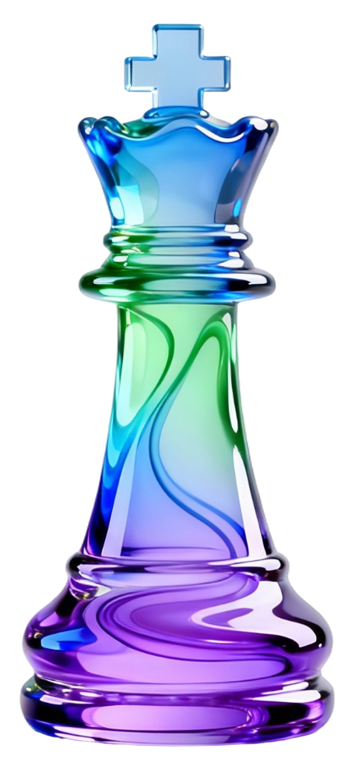
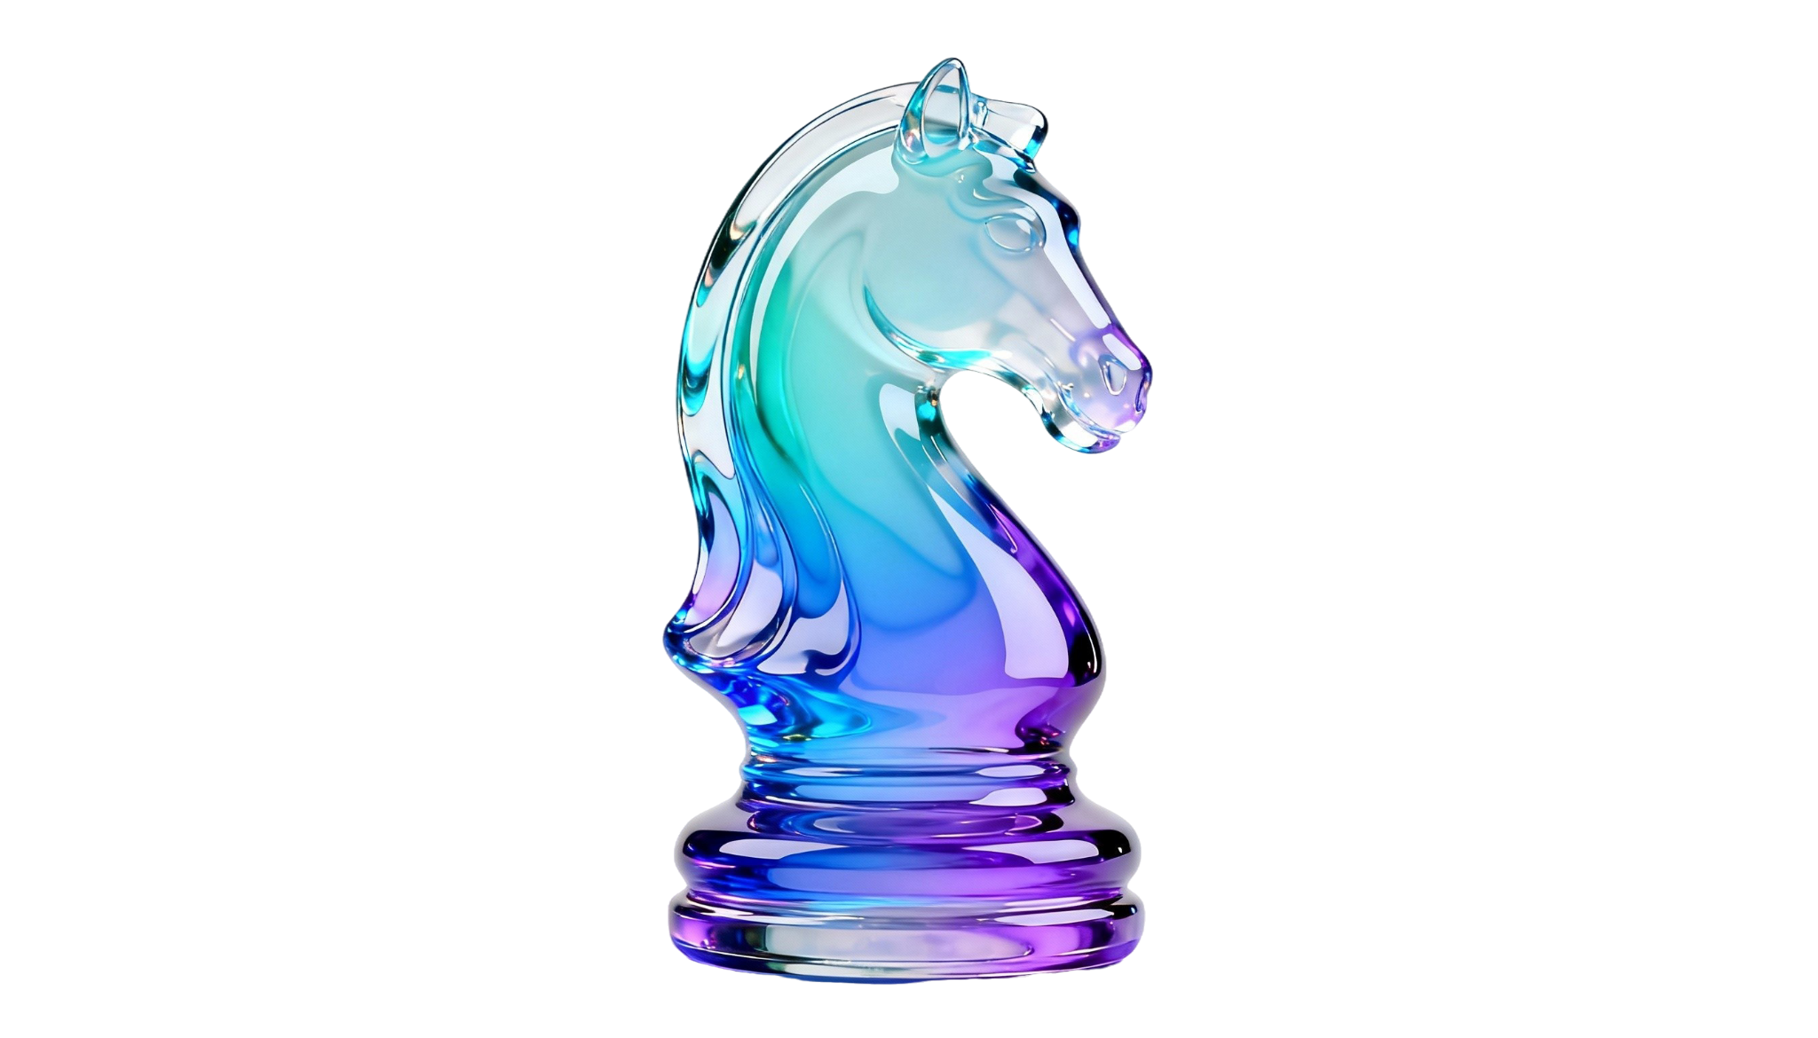
Strategy infographics
Neptune is the fourth-largest planet in the Solar System
Strategy 01
Venus has a beautiful name and is the second planet from the Sun
Business strategy
Earth is the third planet from the Sun and the only one that harbors life
Mercury is the closest planet to the Sun and the smallest one in the Solar System. This planet’s name has nothing to do with the liquid metal
Despite being red, Mars is actually a cold place. It’s full of iron oxide dust
Strategy 01
Jupiter is the fourth-brightest object in the night sky and is a gas giant
Saturn is a gas giant and has several rings. It has a high number of moons

Slide 12
Icon pack
This template has been created by Slidesgo

Slide 13
Instructions for use (premium users)
As a Premium user, you can use this template without attributing Slidesgo
You are allowed to:
Modify this template
Use it for both personal and commercial projects
Share this template in an
editable format
Hide or delete the “Thanks” slide and the mention to Slidesgo in the credits
You are not allowed to:
Sublicense, sell or rent any of Slidesgo Content
Distribute Slidesgo Content unless it has been expressly authorized by Slidesgo
Use any of the elements that are part in a separated way
Register any of the elements as a trademark or logo in an intellectual property registry
For more information about editing slides, please read our FAQs or visit our blog

Slide 14
Infographics
You can add and edit some infographics to your presentation to present your data in a visual way.
Choose your favourite infographic and insert it in your presentation using Ctrl C + Ctrl V or Cmd C + Cmd V in Mac
Remember to choose the “Keep source formatting” option so that it keeps the design. For more info, please visit our blog
01
07
Select one of the parts and ungroup it by right-clicking and choosing “Ungroup”
Repeat the steps above with the other parts and when you’re done editing, copy the end result and paste it into your presentation
02
06
03
Change the color by clicking
on the paint bucket
05
Group the elements again by selecting them, right-clicking and choosing “Group”
Then resize the element by clicking and dragging one of the square-shaped points of its bounding box (the cursor should look like a double-headed arrow). Remember to hold Shift while dragging to keep the proportions
04

